Slide 1

Predictive Analytics Technical Project
Abul Mohsin

Slide 2
Abstract
Developed a predictive medical diagnostic system using Gradient Boosting, XGBoost, LightGBM, and a Voting Classifier.
Addressed correlation between symptoms and missing data.
Achieved high diagnostic precision through an ensemble model approach.

Slide 3
Introduction
Problem Statement
Manual diagnostic systems are often delayed and inaccurate.
Aim: Automate disease prediction using patient symptoms.
Objectives
Build an end-to-end predictive analytics pipeline.
Address class imbalance for unbiased predictions.
Utilize ensemble models for improved diagnostic accuracy.
Significance
Enhance healthcare delivery by improving diagnostic accuracy and timeliness.

Slide 4
Dataset and Preprocessing
Dataset Description
Training data: 132 symptoms, 41 diseases, 4920 records.
Testing data: 42 patients, same features.
Preprocessing Steps
Removed irrelevant columns.
Ensured balanced class distribution (120 cases per disease).
Encoded categorical data.
Performed correlation analysis to address feature dependencies.
Split data into training and testing sets.

Slide 5
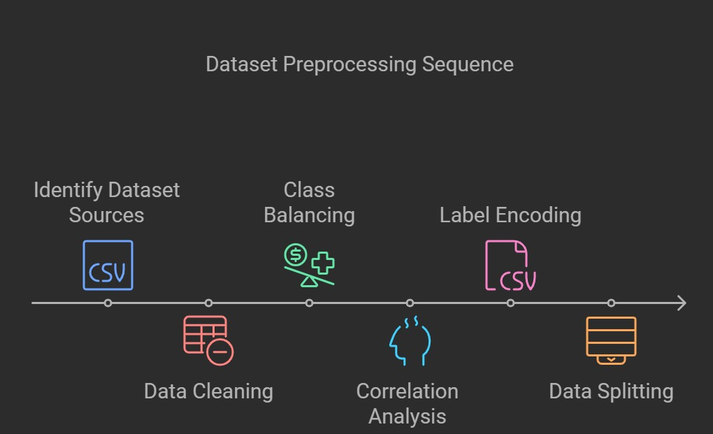
Dataset and Preprocessing

Slide 6
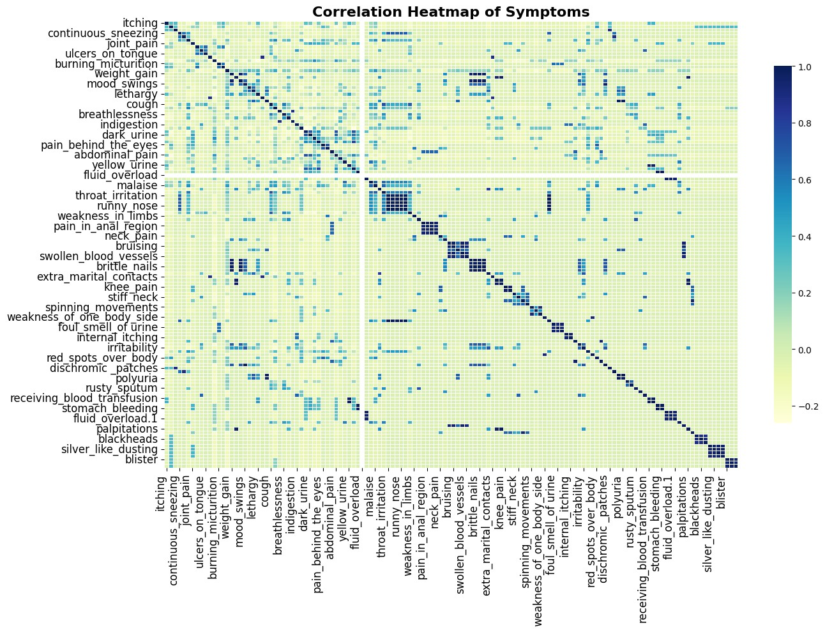
Correlation Analysis using Heatmap

Slide 7
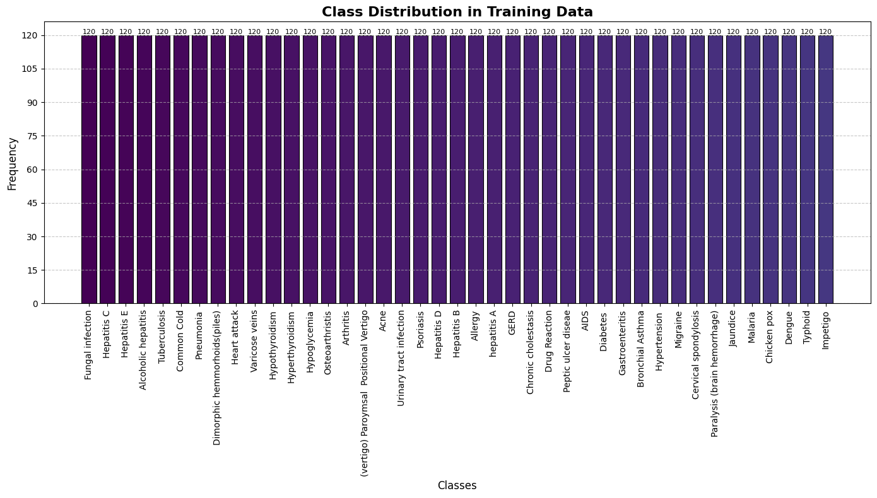
Class Distribution Analysis using Barplot

Slide 8
Methodology
Predictive Analytics Pipeline
Data Collection
Data Preprocessing
Feature Engineering
Model Selection
Model Training
Model Evaluation
Models Used
XGBoost: Handles large datasets effectively.
SVM: High precision with PCA.
Logistic Regression: Baseline model with ElasticNet regularization.
Voting Classifier: Combines models for better generalization.

Slide 9
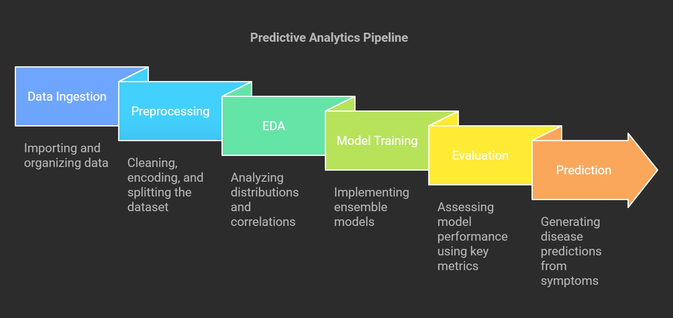
Methodology Pipeline Diagram

Slide 10
Evaluation Metrics
Model | Accuracy | Precision | Recall | F1-Score | ROC-AUC | Training Time (s)
XGBoost | 0.98 | 0.99 | 0.98 | 0.98 | 1.00 | 0.9993
SVM | 1.00 | 1.00 | 1.00 | 1.00 | 1.00 | 2.2554
Logistic Regression | 1.00 | 1.00 | 1.00 | 1.00 | 1.00 | 9.9572
Voting Classifier | 1.00 | 1.00 | 1.00 | 1.00 | 1.00 | 6.6139

Slide 11
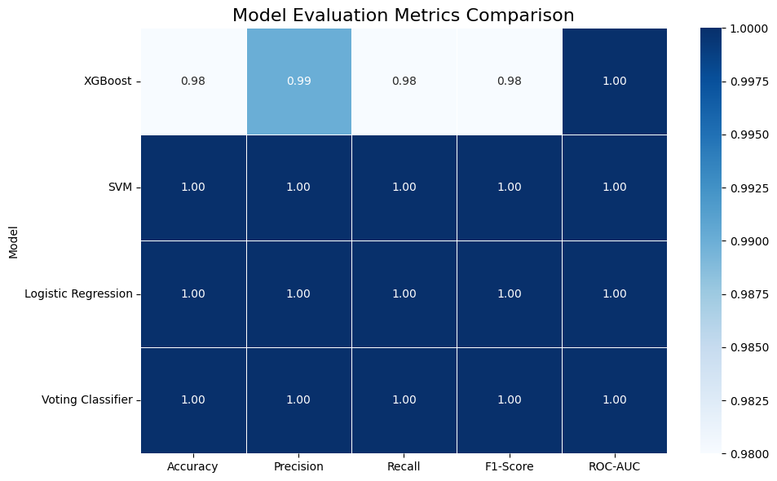
Evaluation Metrics using Heatmap

Slide 12
Results and Discussion
Performance Insights
All models achieved high accuracy; SVM and Voting Classifier performed best.
XGBoost provided competitive performance with faster training.
Logistic Regression and Voting Classifier took longer to train.
Model Diversity
Voting Classifier offers robust generalization by combining models.
XGBoost provides a unique approach with gradient boosting.

Slide 13
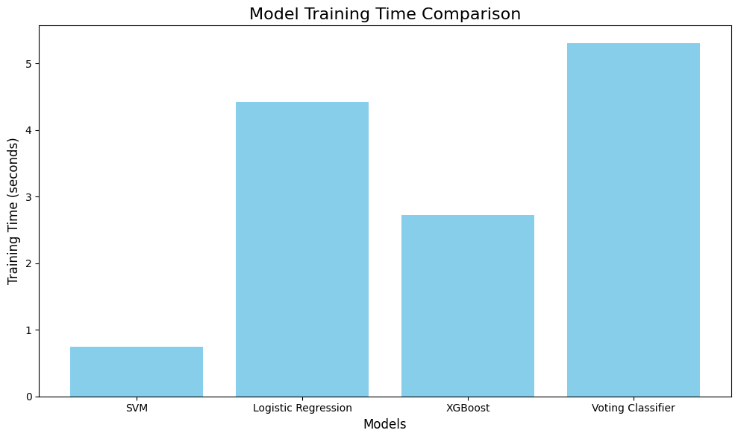
Training Time Diagram using Barplot

Slide 14
Conclusion
Summary
Successfully developed a predictive diagnostic system.
Leveraged ensemble models for high accuracy.
Future Work
Explore deep learning methods.
Expand dataset to include more diseases and symptoms.
Investigate real-time clinical deployment.

Slide 15
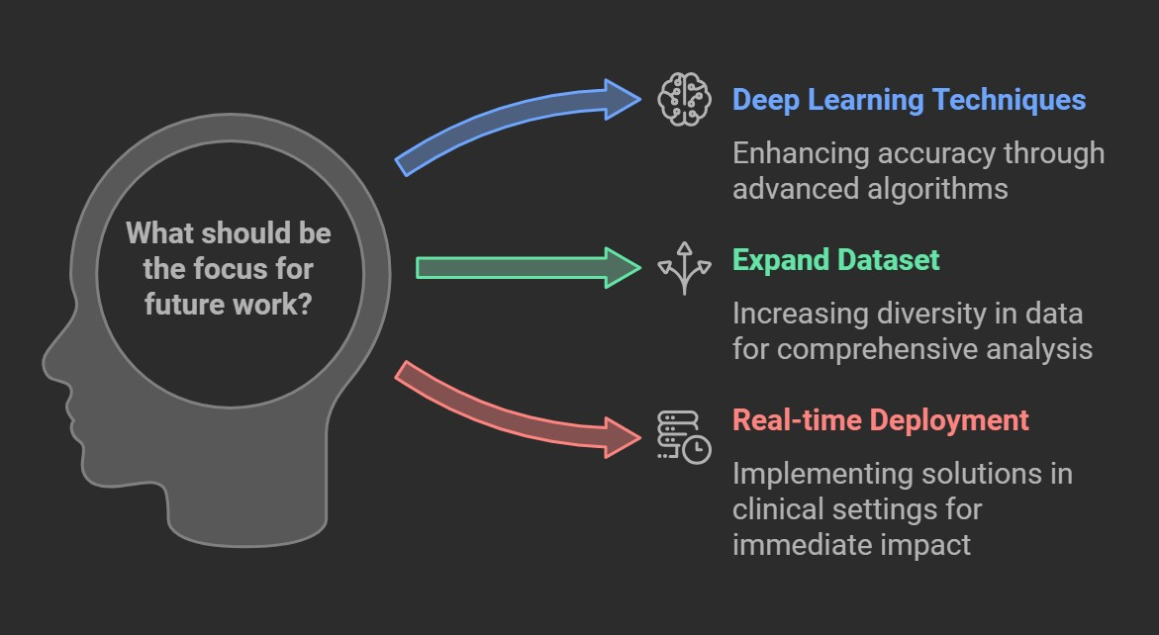
Future Work

